Slide 1

Securing the Maternity Ward Network: A HIPAA-Focused Redesign
Adrian Joco – Networking Engineer Mariah Rodgers – Security Engineer Diamond Williams – Project Manager

Slide 2
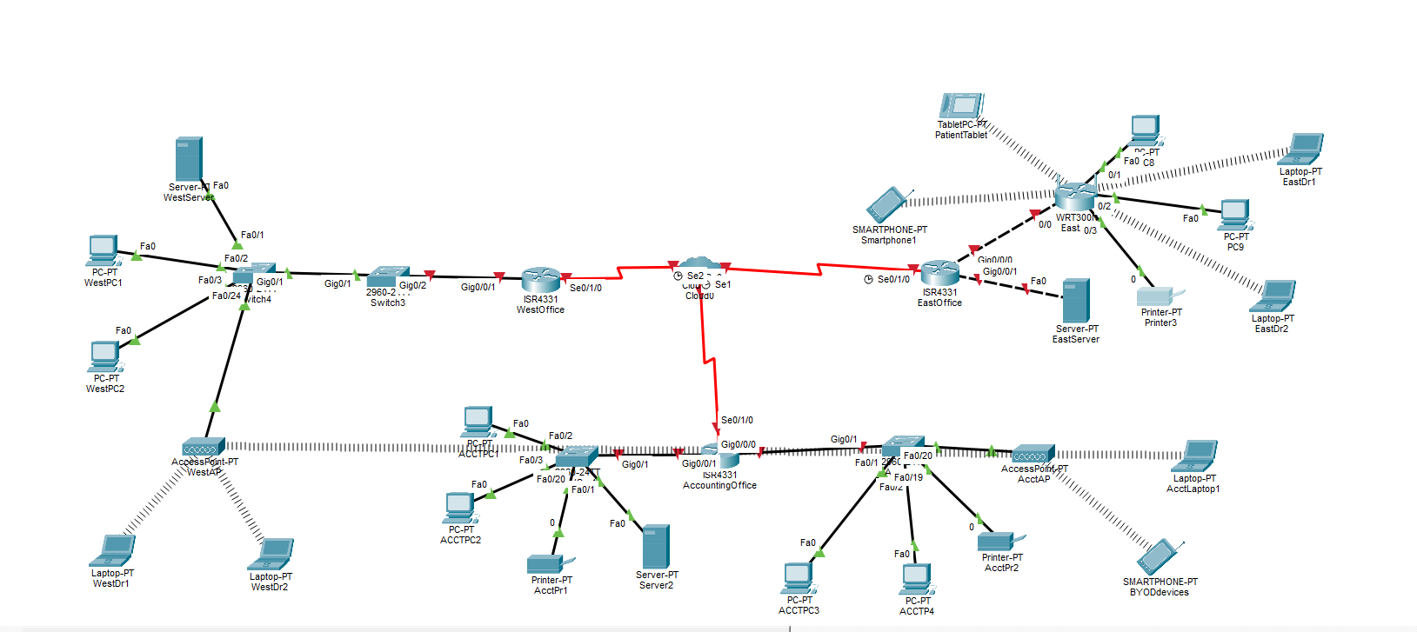
The original network
Notes:
This network is flat and too open. No firewalls, no vlans etc. Notice what you don't see.

Slide 3
Issues with the original network
The network is too open and is not securely segmented.
The design appears to be based on device location rather than security roles.
There is no firewall protection in place.
Traffic can move laterally across the network.
Servers containing sensitive data are reachable by all users.
BYOD devices and patient devices have the same level of access as staff devices.
There is a lack of TACACS+/RADIUS authentication and centralized access control.
Protected health information is not being properly secured in accordance with HIPAA requirements.

Slide 4
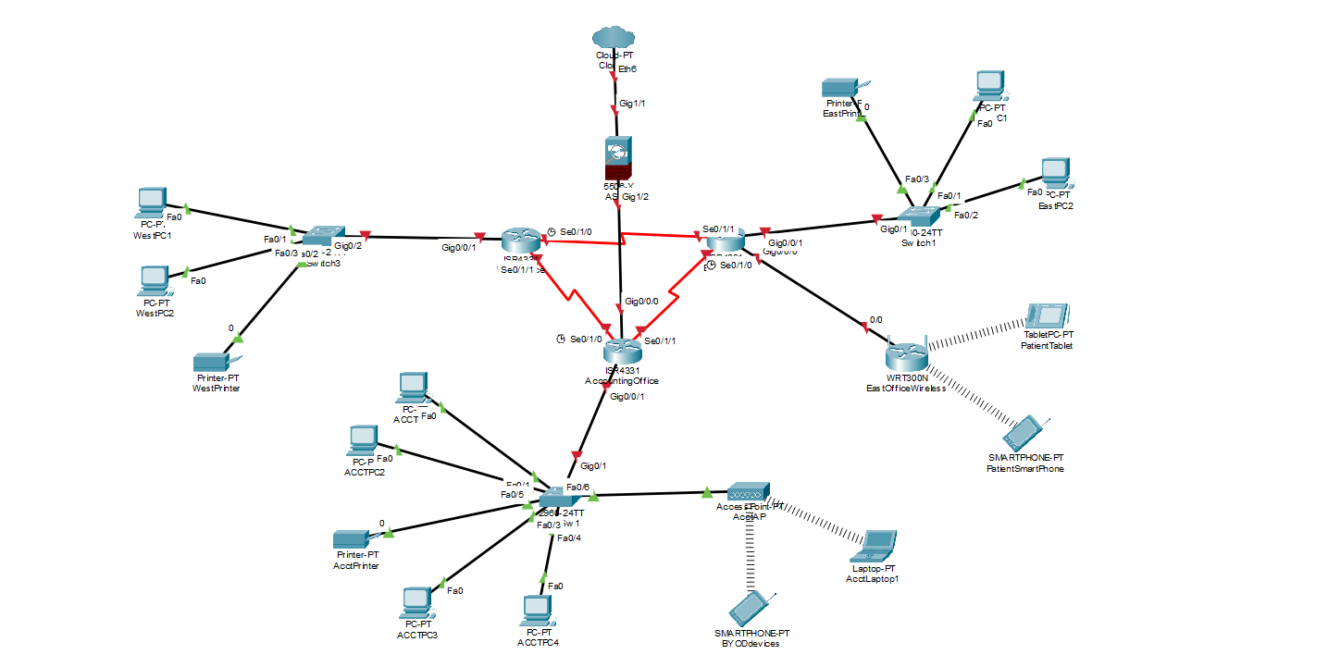
The upgraded network

Slide 5
What we changed to the network
Reconfigured the main routers into a triangle pattern.
Servers: static IPs and firewalls.
DHCP IPs for doctors, patients and staff.
Added ACLs restrict intranet access between offices.
A firewall is configured between outside traffic and the inner network.
Notes:
Mariah

Slide 6
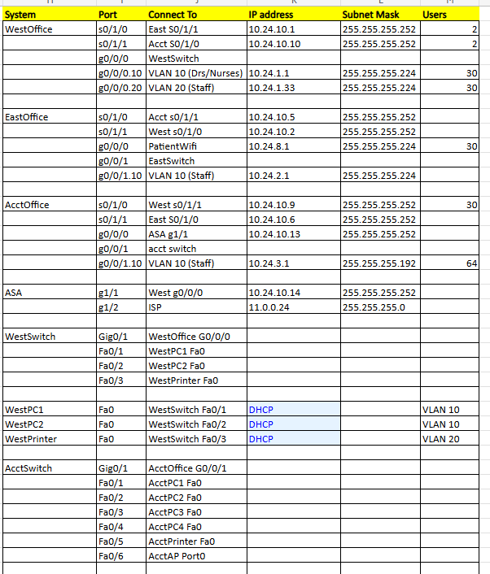
The realistic updated IP Configurations
Notes:
Adrian

Slide 7
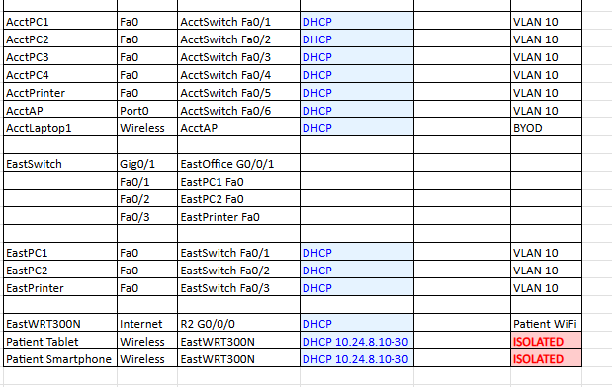
The realistic updated IP Configurations
Notes:
Adrian

Slide 8
In a perfect world
This could be a two-phase plan due to having to order new devices. For example:
There is a 4–12-week lead time on Cisco ASA firewalls.
And a 4-6-week lead time on Cisco ISR 4331 routers.
We could install some software upgrades in the meantime, but we will have to come back and install the physical hardware when it all arrives or wait and make all the upgrades all at once.

Slide 9
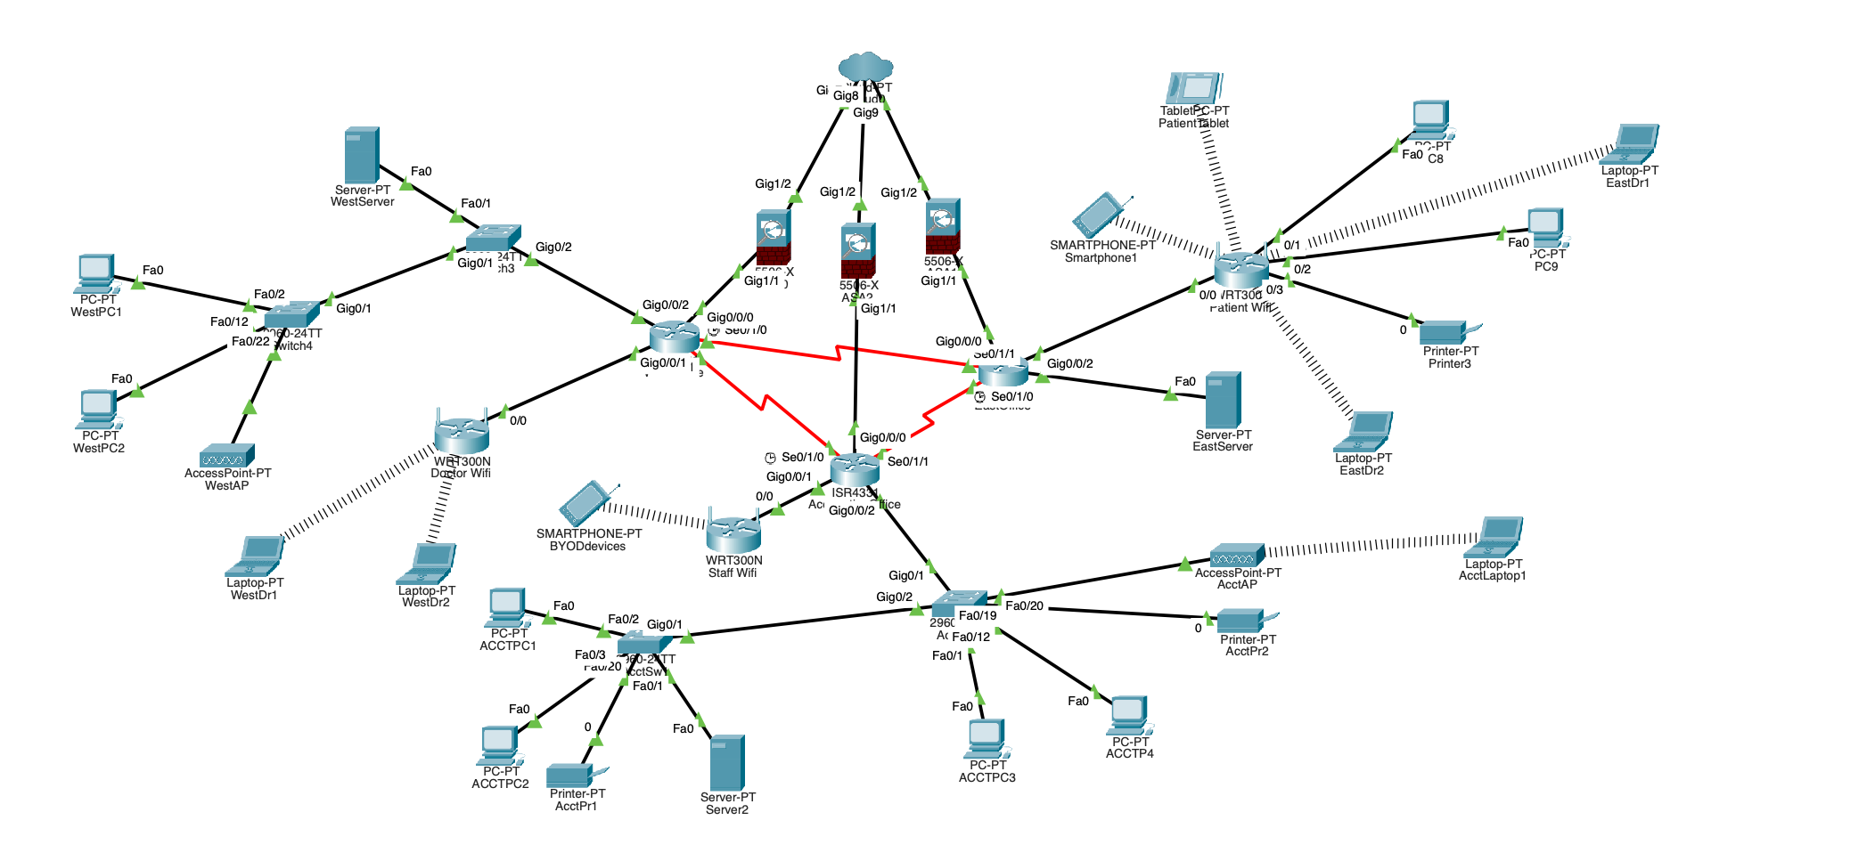
The ideal network

Slide 10
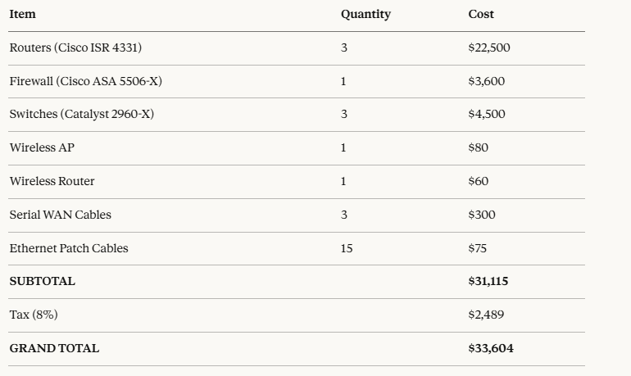
Network devices, Uses & Cost (Realistic)
Notes:
Adrian

Slide 11
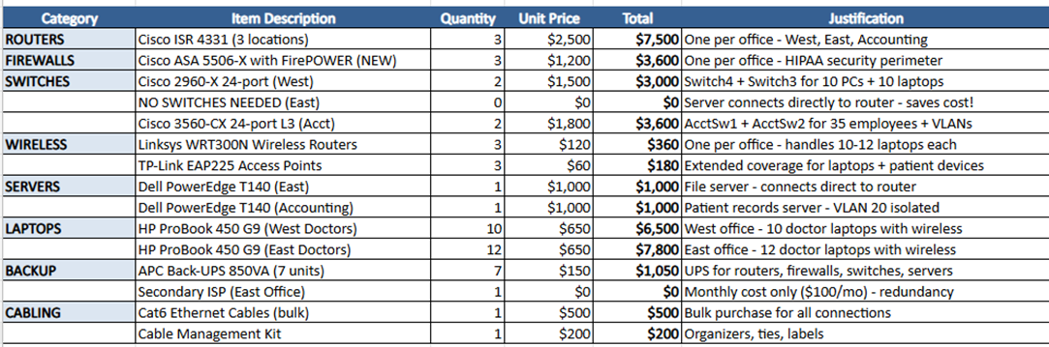
Network devices, Uses & Cost (Hypothetical)
Notes:
Adrian

Slide 12
FAQs
Since the current network is "shaky" (low latency) this issue will be resolved by all the upgrades being made.
Workstations will automatically log off a user after a time set by the client.
For portable devices; we will use RADIUS software on the wireless router, require login credentials to the Wi-Fi, and all devices MUST HAVE a password, MFA, encryption and a screen lock.
Under no circumstances, will any Protected Health Information (PHI) be able to be stored on personal devices.
The IT professional will be able to run audit logs, and they will be retained for 6 months.
With a future expansion, it'll allow for a better back up plan and redundancies.

